Slide 1
FPGA Board
Date 2007.3.8
SMT RnD Div 2

Slide 2
Contents
FPGA Board
PCI Expansion Board
MAC PHY Interface
P/O

Slide 3
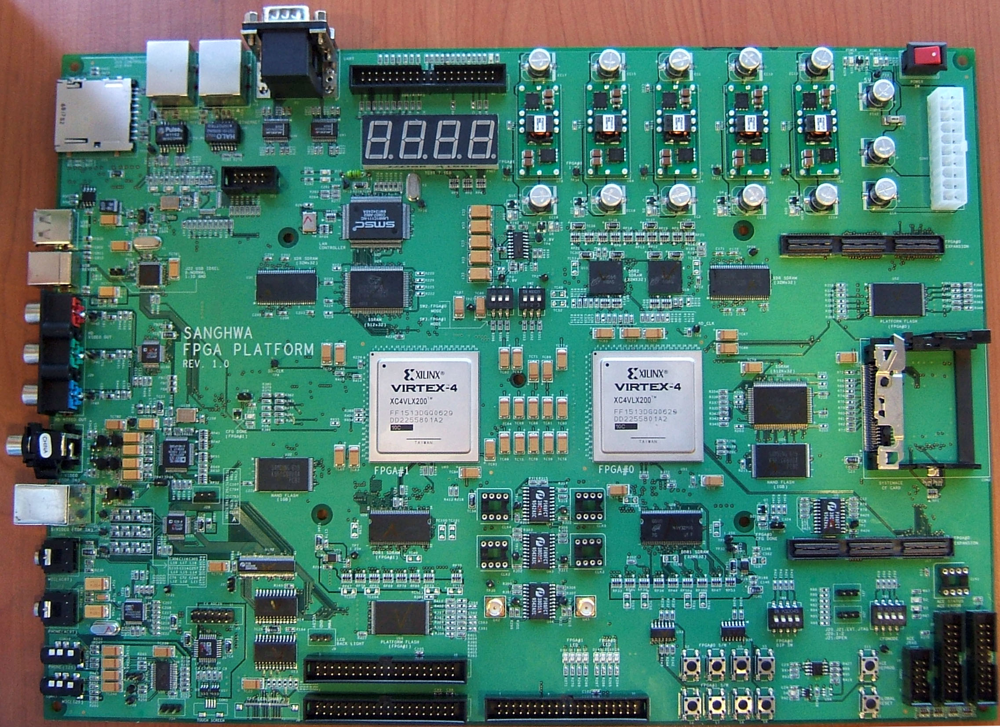
FPGA Board
PCI Expansion Board
PCI Adaptor Board
ROM Emulator Socket
FPGA
MICTOR Adaptor Board
RF Board

Slide 4
PCI Expansion Board
PCI Expansion Board
PCI Adaptor Board
Vertex4
LX60 – FF668
Grade 낮 은것.
모든 가용 Pin을 Connector에 연결
그리고 일부를 ROM Emulator
Socket에 공유
공유된 Pin은 0Ohm 저항으로 Isolation
ROM Emulator Socket
FPGA
연결 Connector는 최대한 짧은 거리를 유지

Slide 5
PCI Expansion Board
Power Socket
HDD Type
Regulator
Circuit
OSC Socket
FPGA
Signal from/to
PCI Adaptor Board
Signal from/to PCI Socket
7 Seg * 4

Slide 6
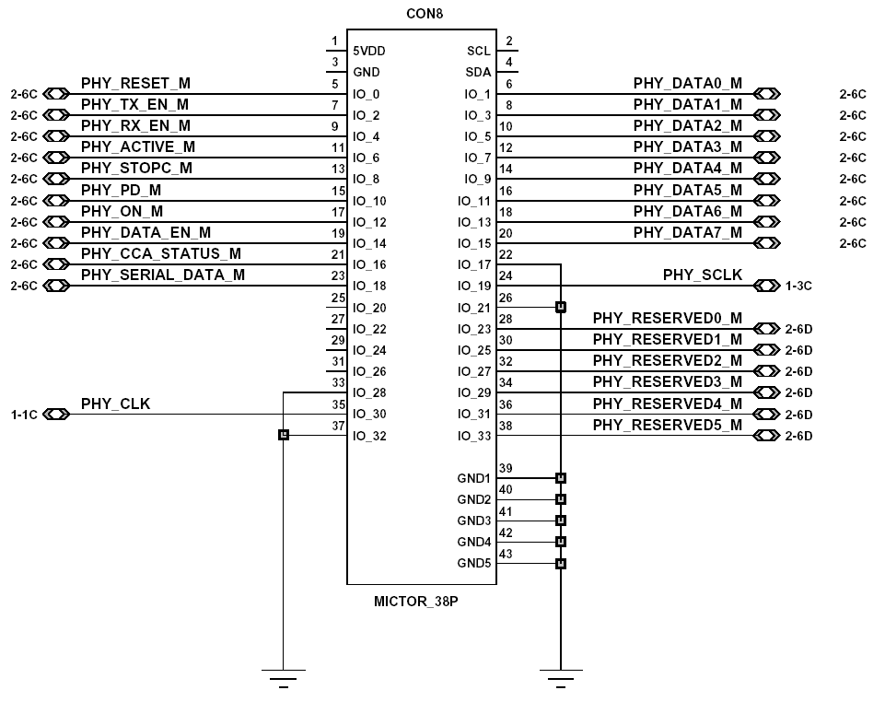
MAC-PHY Interface Connector Drawing

Slide 7
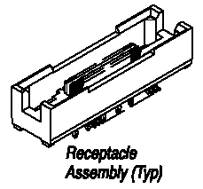
MAC-PHY Interface Connector
Manufacturer Part #: | 5767054-1
Manufacturer: | Tyco Electronics / AMP
Description: | MICTOR Connectors 38P RECEPTACLE
Product Highlights:
Connector
Receptacle
Mated Stack Height (Vertical) = 6.60 mm
Number of Positions = 38
Vertical Mount Angle

Slide 8
Interface Signal Definition(1/2)
Signal Name | From | To | Description
PHY_RESET | MAC | PHY | PHY Reset
PHY_PD | MAC | PHY | Power Down
PHY_ON | MAC | PHY | PHY Sleep/Idle
PHY_SCLK | PHY | MAC | Serial Interface Clock
PHY_SERIAL_DATA | MAC/PHY | PHY/MAC | Serial Interface Data Register Access
PHY_DATA_EN | PHY | MAC | Parallel Interface Enable
PHY_CLK | PHY | MAC | Parallel Interface Clock
PHY_DATA[7:0] | MAC/PHY | PHY/MAC | Parallel Interface Data

Slide 9
Interface Signal Definition(2/2)
Signal Name | From | To | Description
PHY_TX_EN | MAC | PHY | Transmission Enable
PHY_RX_EN | MAC | PHY | Reception Enable
PHY_ACTIVE | PHY | MAC | PHY Active
PHY_STOPC | MAC | PHY | PCLK ON/OFF
PHY_CCA_STATUS | PHY | MAC | CCA status
PHY_RESERVED[5:0] | MAC/PHY | PHY/MAC | Reserved signals

Slide 10
P/O
Total 4 Set
  PCI Expansion board 4 Set
  MAC/PHY Adaptation board 4 Set
Schedule
  Start : 2007/3
    견적서 확인 후 Start
  End : 2007/5/4
Price/Date
  TBD

